Slide 1
RECONCILIATION HOUSE
WEALTH CREATION HUB
AMAZON BEST SELLING BOOKS ANALYSIS
BABATUNDE AYEDOJU

Slide 2
INTRODUCTION
The world of literature is a dynamic one full of changes in patterns that are informed by several factors that include but are not limited to readers’ interest and cultural trends or societal value systems. This project “Amazon Best Selling Books Analysis” investigates selected books published by Amazon over a period of ten years (2009 – 2019), putting into consideration the authors, prices, reviews and user ratings.
At the end, the result of the analysis helps to discover the highly rated books based on the way users rate them and the reviews they have generated.
In a nutshell, the Analysis helps to understand the performance of each book and the author.

Slide 3
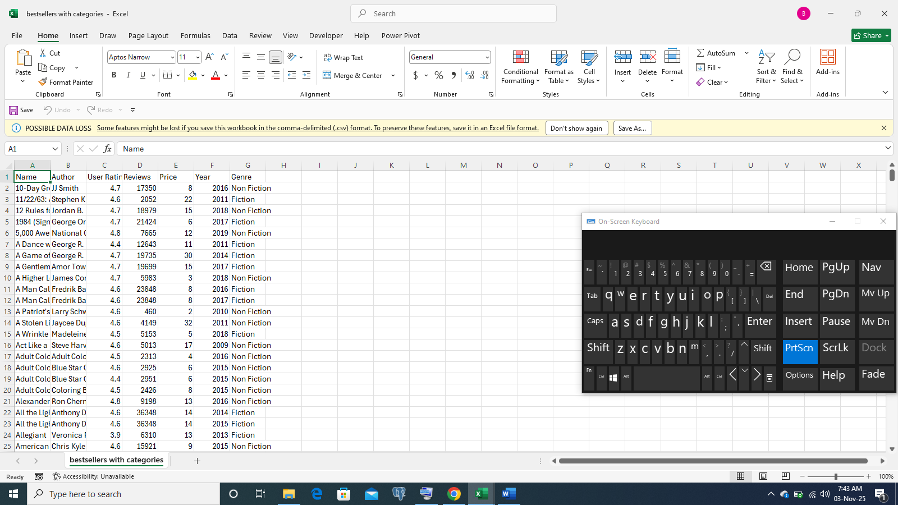
RAW DATA
The raw data was obtained from Kaggle.com the way it appears below:

Slide 4
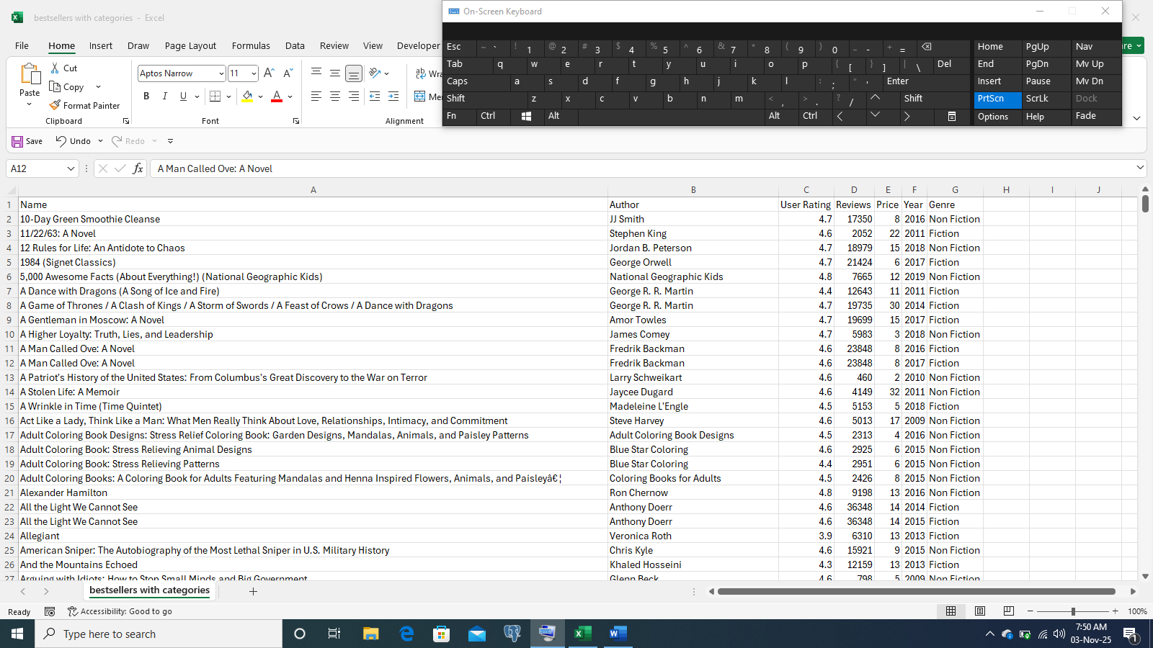
RAW DATA
Continuation:

Slide 5
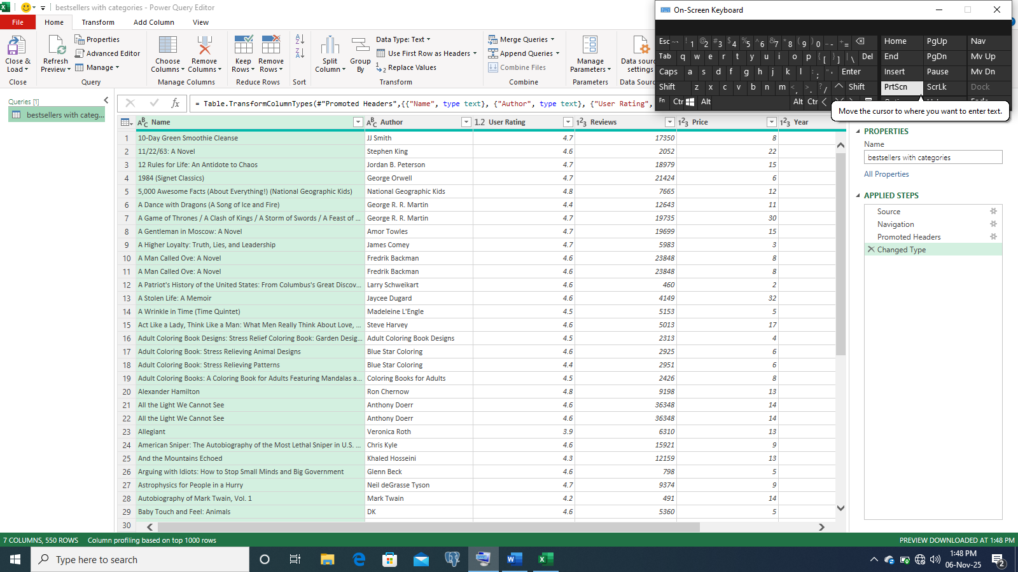
The data was cleaned using power query:

Slide 6
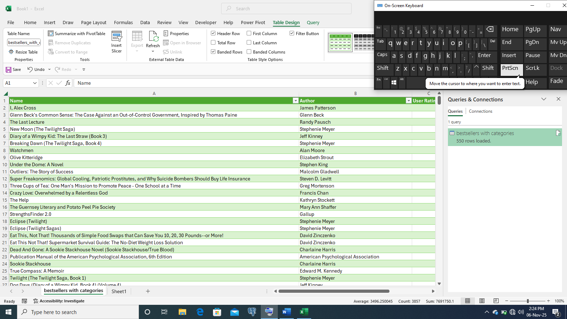
Thereafter, it was imported to a Microsoft Excel sheet:

Slide 7
POWER BI

Slide 8
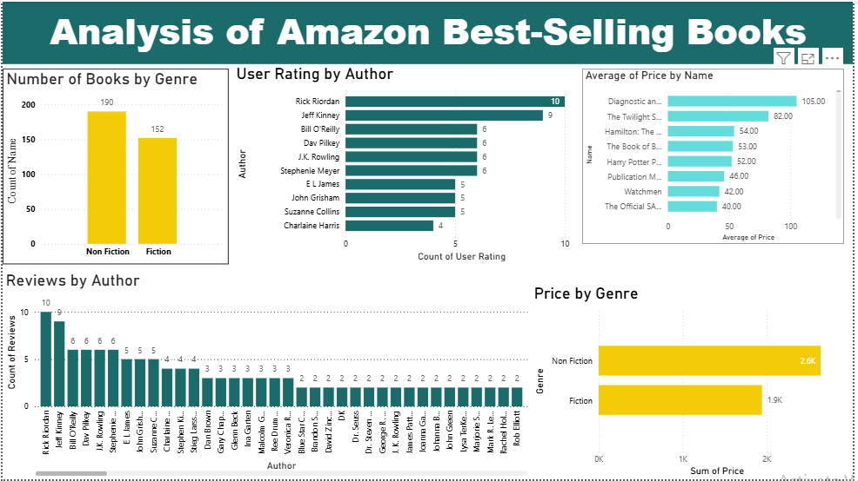

Slide 9
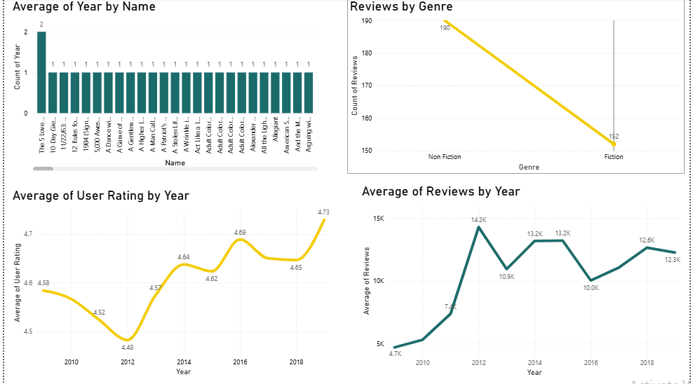

Slide 10
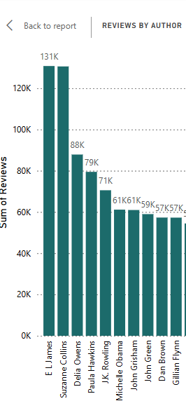
SUM OF REVIEWS BY AUTHORS

Slide 11
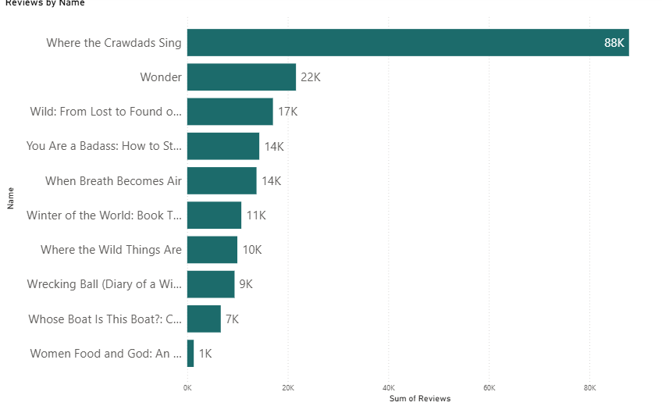
Reviews by Names

Slide 12
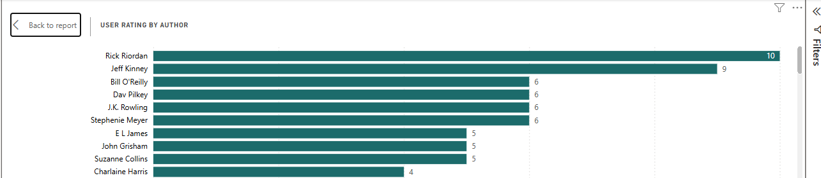
USER RATING BY AUTHOR

Slide 13
OBSERVATIONS
Non-fiction books had more sales than fiction books.
Non-fiction books had a higher price than fiction books.
Non-fiction books had a larger sum of reviews than fiction books.
Rick Riordan had the highest user rating of 47.7, while Harper Lee had the lowest user rating with 3.6.
Diagnostic and Statistical Manual of Mental Disorders, 5th Edition; DSM-5, written by the American Psychiatric Association was sold for the highest price - $105, while Eat This Not That! Supermarket Survival Guide: The No-Diet Weight Loss Solution by David Zinczenko was sold for the lowest price of $1.

Slide 14
OBSERVATIONS
Where the Crawdads Sing by Delia Owens had the highest sum of reviews with 87,841, while Divine Soul Mind Body Healing and Transmission System: The Divine Way to Heal You…..by Zhi Gang Sha had the lowest with 37.
E L James had the highest sum of reviews (130,746), while Zhi Gang Sha had the lowest sum of reviews (257).
Year 2019 had the highest average of user rating, while 2012 had the lowest.
Year 2012 had the highest average of reviews, while 2009 had the lowest.

Slide 15
RECOMMENDATIONS:
Zhi Gang Sha had the lowest review as an author. His book also had the lowest review. There should be an appraisal or possibly a reappraisal of his books to know what could be wrong, possibly they are not meeting the demands of the public.
Others who also had low user ratings and reviews should probe into market demands to be able to serve their readers better subsequently.

Slide 16
THANK
YOU

